Slide 1
Teaching Remotely and online
Sharing Best Practice with Online Delivery

Slide 2







How many of you can Recognise the Icons on the screen?
Notes:
What would you say if I told you through out-lock down I have used all of these to help engage students in different remits of learning.

Slide 3

Engaging students
Granted these three are going to be slightly more tricky to use with more academic subjects.
However I thought it was important to incorporate how I have been using them to engage students, but also to help promote courses.

Slide 4
What has Help Me the most through Lock down!

Slide 5
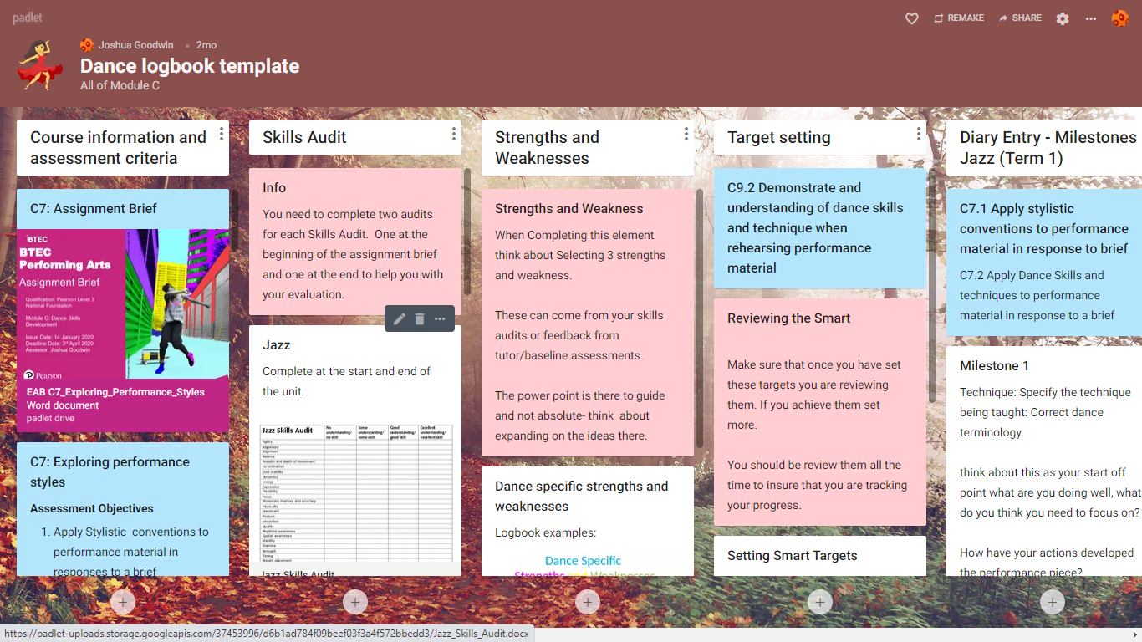
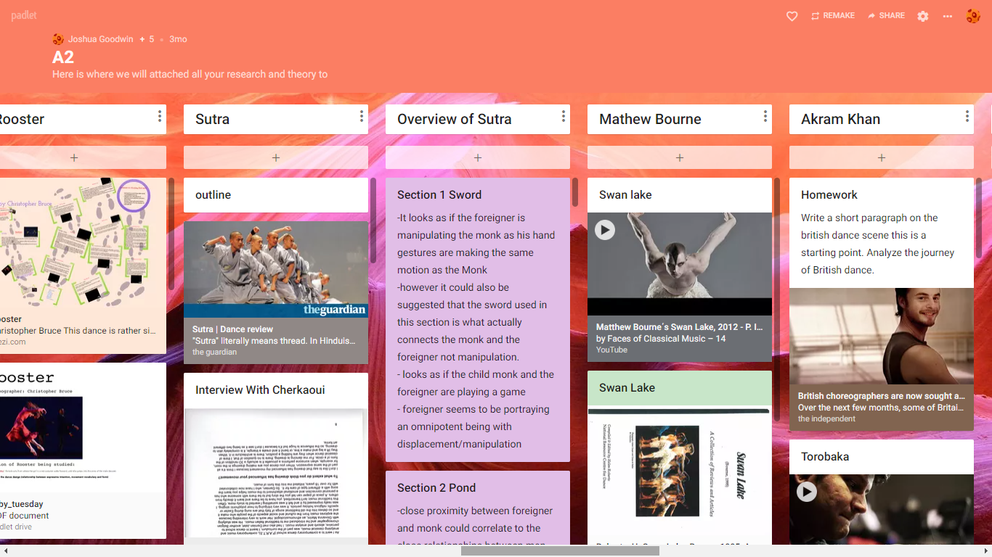
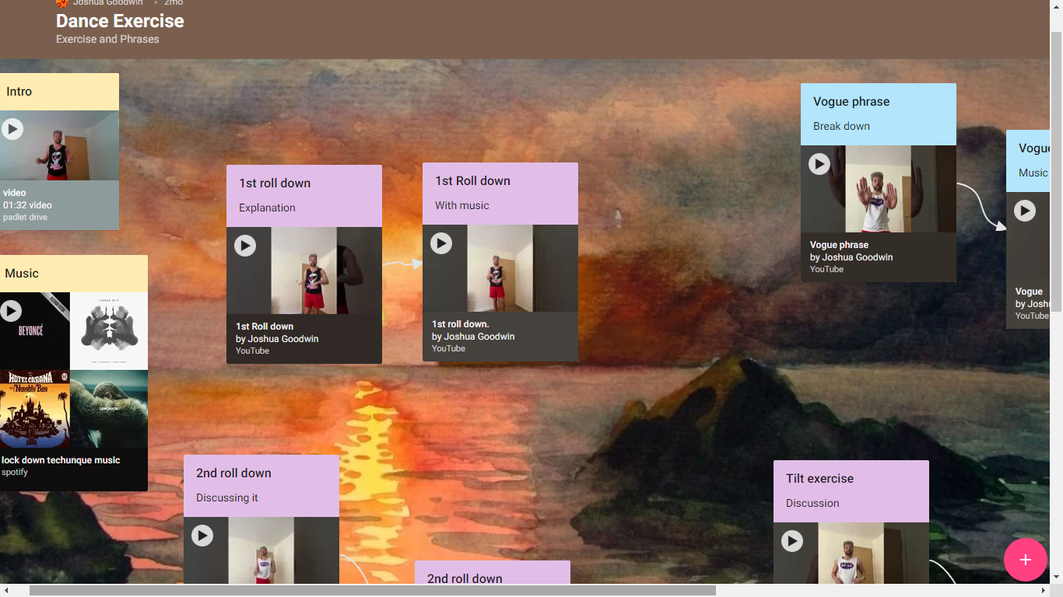
How I’ve use Padlet through Lockdown
There are loads of way you can use this application, it works well both on a laptop or interfacing with any smartphone.
Picture one is a template which student remake and completed all task
Two works in real time and help build up their revision
Picture 3, is a series of videos I have uploaded throughout lock down to help with dancers technique.

Slide 6
Overview of using online tools and Application

Slide 7
My Experience Of Padlet
It’s your own personal Moodle!
It works in real time, so you can share a link and see them working.
You can use a range of software and applications within it.

Slide 8
My Experience Of Team’s
Key elements I think you need to focus on.
Using the hand up really helps.
Don’t do big numbers.
The mute button is your friend.

Slide 9
My Experience of Click view and Kahoot
Both of these are great tools to set work for learners to do in their own time and then for you to check on their progress at the end.
Kahoot is a great all-round revision tool and checking their knowledge.
ClickView is a great tool to help assisted with learning.

Slide 10
The key to delivering online content is to enjoy what Your USING.
Any question?

